Slide 1
Building The Data Warehouse by Inmon
VSV Training
Chapter 4: Granularity in the Data Warehouse
Prepared by: Vinh Tao – Hien Bui
Date: 09/01/2008

Slide 2
4.0 Introduce - Granularity in the Data Warehouse
Determining the proper level of granularity of the data that will reside in the data warehouse.
Granularity is important to the warehouse architect because it affects all the environments that depend on the warehouse for data.

Slide 3
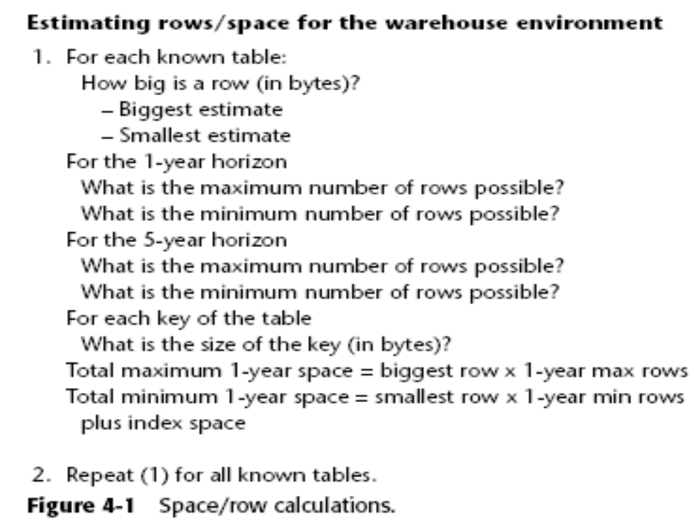
4.1 Raw Estimates
The raw estimate of the number of rows of data that will reside in the data warehouse tells the architect a great deal.

Slide 4
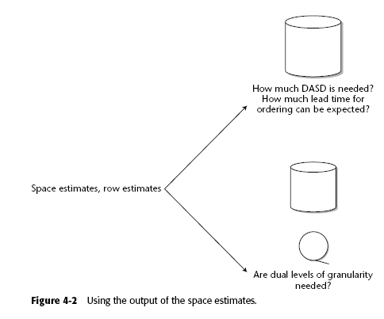
4.2 Input to the Planning Process
The estimate of rows and DASD then serves as input to the planning process

Slide 5
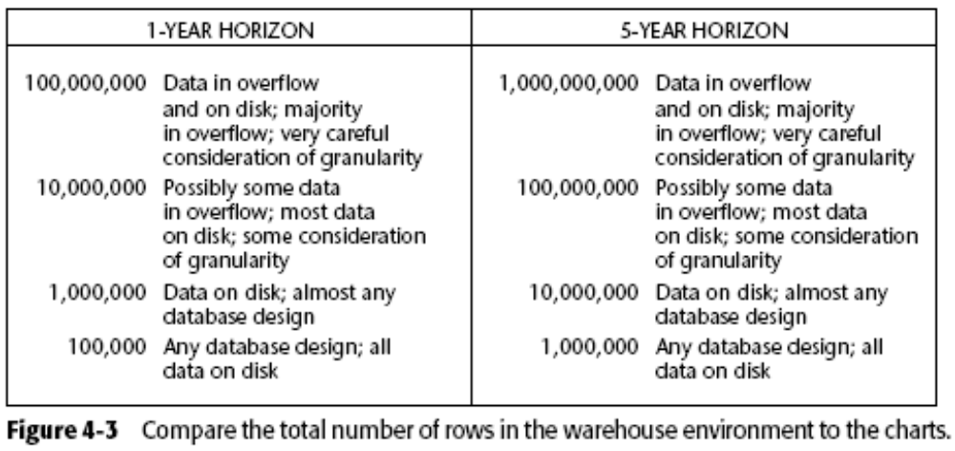
4.3 Data in Overflow
Compare the total number of rows in the warehouse environment:

Slide 6
4.3 Data in Overflow (ct)
There will be more expertise available in managing the data warehouse volumes of data.
Hardware costs will have dropped to some extent.
More powerful software tools will be available.
The end user will be more sophisticated.

Slide 7
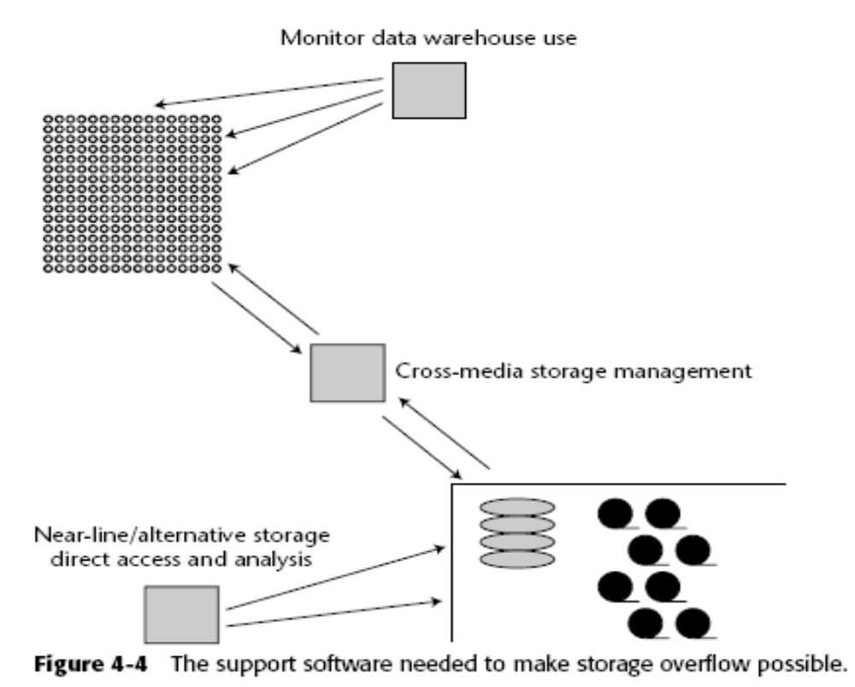
4.3.1 Overflow Storage

Slide 8
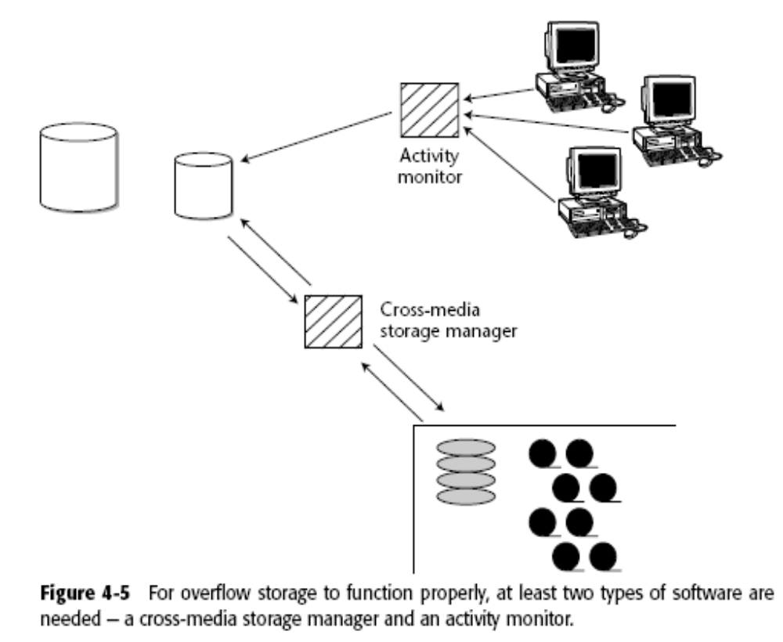
4.3.1 Overflow Storage (ct)

Slide 9
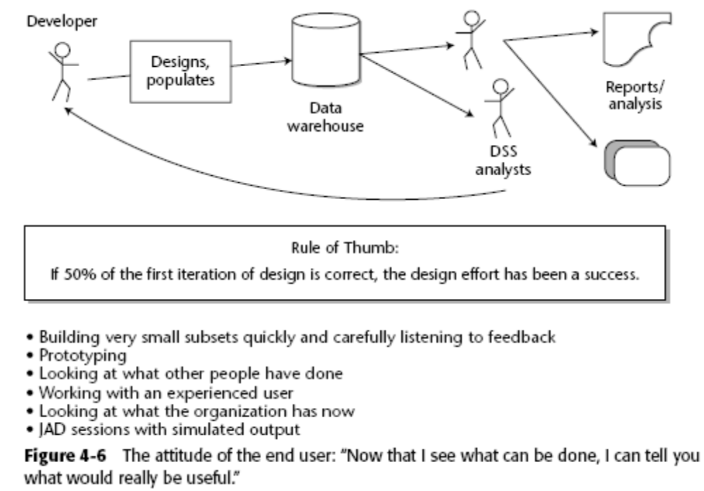
4.4 What the Levels of Granularity Will Be

Slide 10
4.5 Some Feedback Loop Techniques
Following are techniques to make the feedback loop harmonious:
Build the first parts of the data warehouse in very small, very fast steps, and carefully listen to the end users’ comments at the end of each step of development. Be prepared to make adjustments quickly.
If available, use prototyping and allow the feedback loop to function using observations gleaned from the prototype.

Slide 11
4.5 Some Feedback Loop Techniques (ct)
Look at how other people have built their levels of granularity and learn from their experience.
Go through the feedback process with an experienced user who is aware of the process occurring. Under no circumstances should you keep your users in the dark as to the dynamics of the feedback loop.
Look at whatever the organization has now that appears to be working, and use those functional requirements as a guideline.
Execute joint application design (JAD) sessions and simulate the output to achieve the desired feedback.

Slide 12
4.5 Some Feedback Loop Techniques (ct)
Granularity of data can be raised in many ways, such as the following:
Summarize data from the source as it goes into the target.
Average or otherwise calculate data as it goes into the target.
Push highest and/or lowest set values into the target.
Push only data that is obviously needed into the target.
Use conditional logic to select only a subset of records to go into the target.

Slide 13
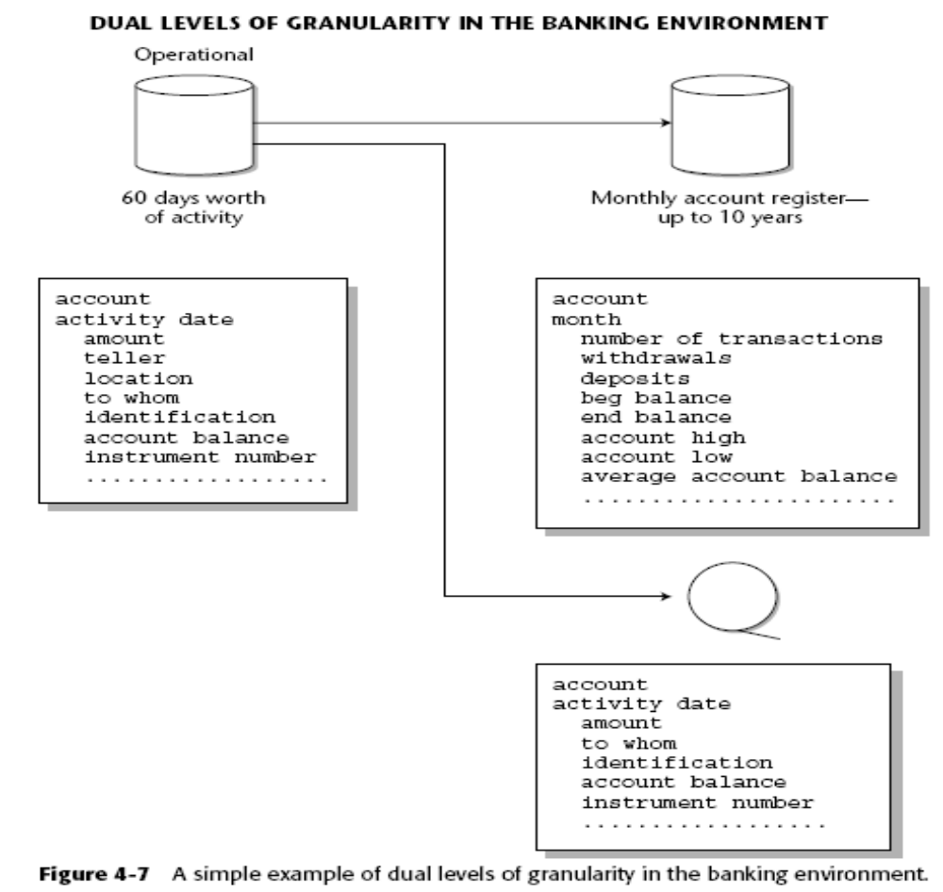
4.6 Levels of Granularity—Banking Environment

Slide 14
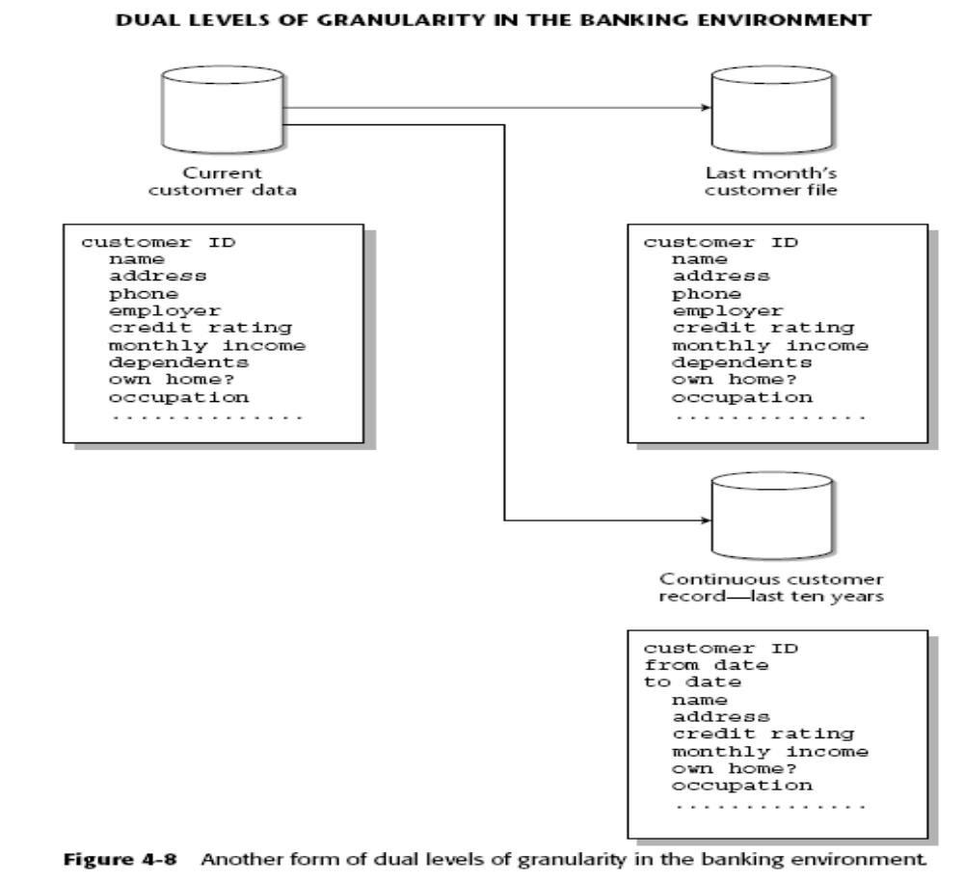
4.6 Levels of Granularity—Banking Environment (ct)

Slide 15
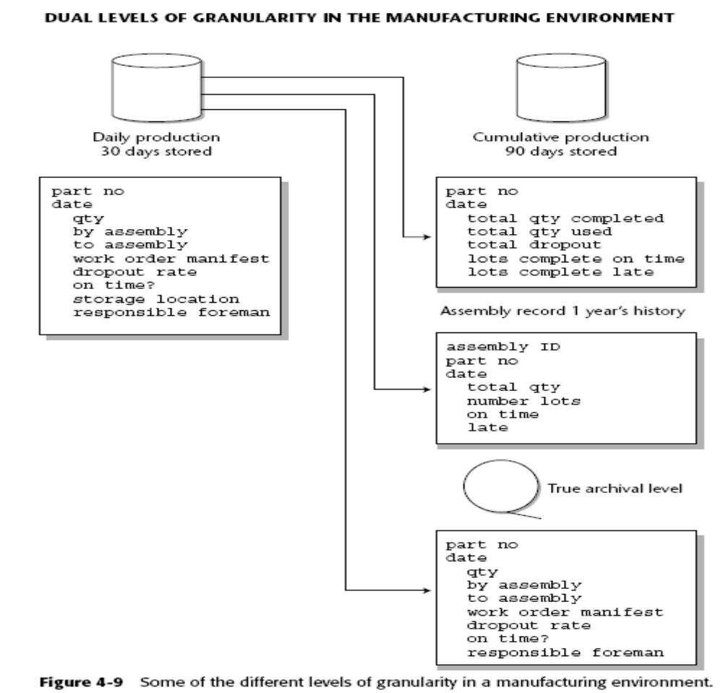
4.6 Levels of Granularity—Banking Environment (ct)

Slide 16
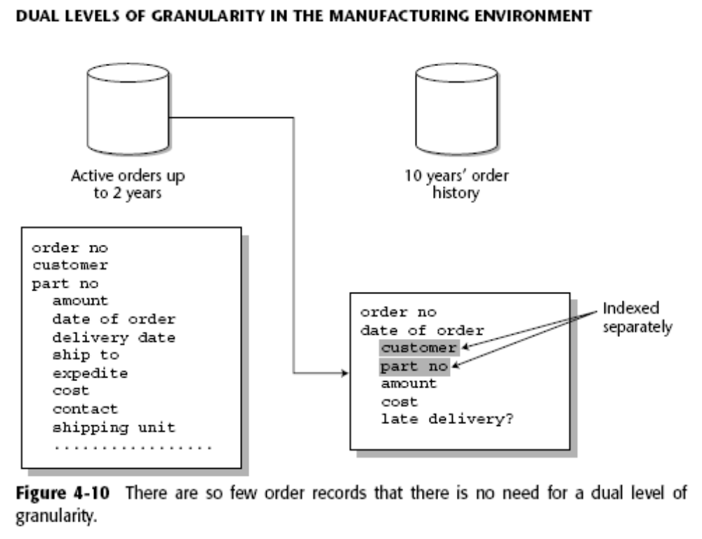
4.6 Levels of Granularity—Banking Environment (ct)

Slide 17
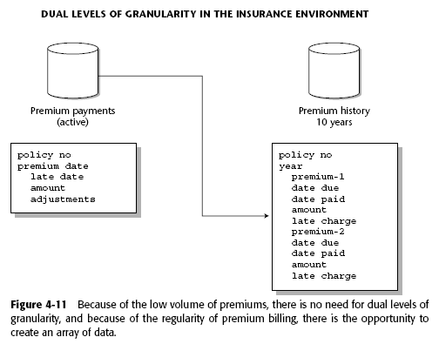
4.6 Levels of Granularity—Banking Environment (ct)

Slide 18
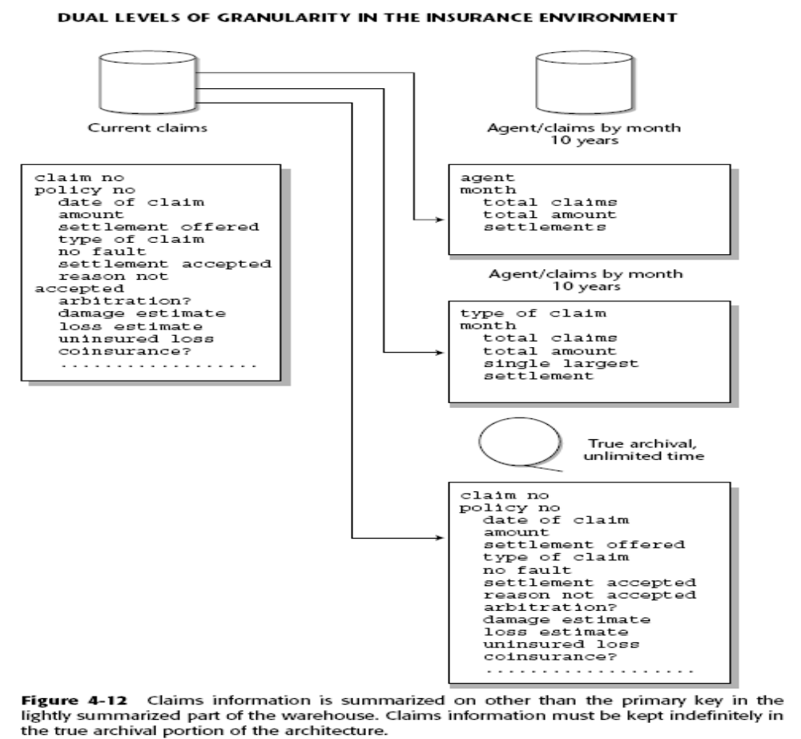
4.6 Levels of Granularity—Banking Environment (ct)

Slide 19
4.7 Feeding the Data Marts
Specification level of granularity the data marts will need.
The data that resides in the data warehouse must be at the lowest level of granularity needed by any of the data marts.

Slide 20
4.8 Summary
Choosing the proper levels of granularity for the architected environment is vital to success.
The worst stance that can be taken is to design all the levels of granularity a priori, and then build the data warehouse.
The process of granularity design begins with a raw estimate of how large the warehouse will be on the one-year and the five-year horizon.
There is an important feedback loop for the data warehouse environment.
Another important consideration is the levels of granularity needed by the different architectural components that will be fed from the data warehouse.

